Slide 1
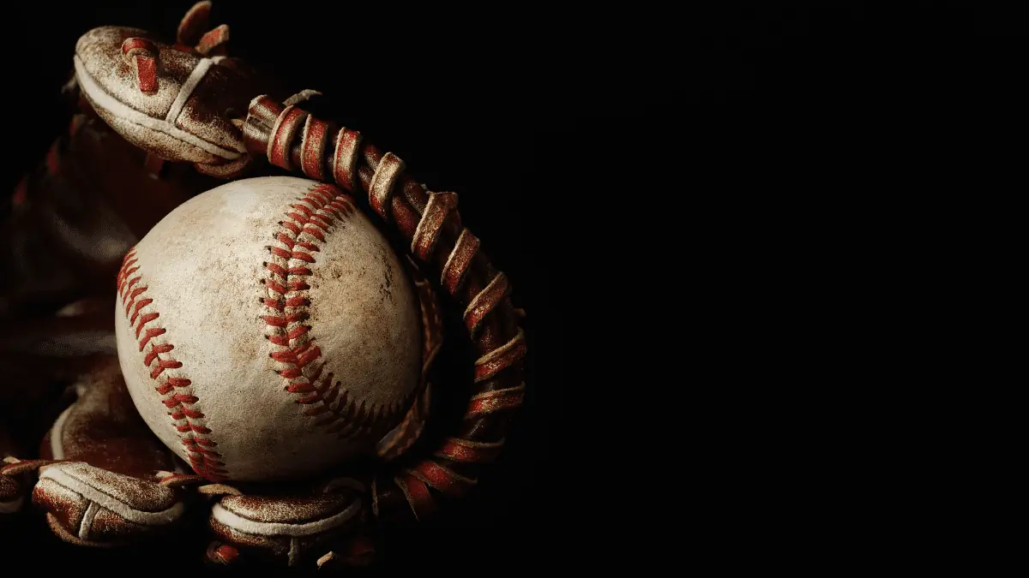
MONEYBALL
BETTER ON A BUDGET
Candy Martinez
Latoya Wenzinger
Mateus Arruda
Ulrich Matthis

Slide 2


Moneyball – The Art of Winning an Unfair Game, by Michael Lewis (2003)
The Oakland Athletics baseball team and its general manager Billy Beane assemble a competitive baseball team despite Oakland’s small budget.
The movie was released in 2011.

Slide 3
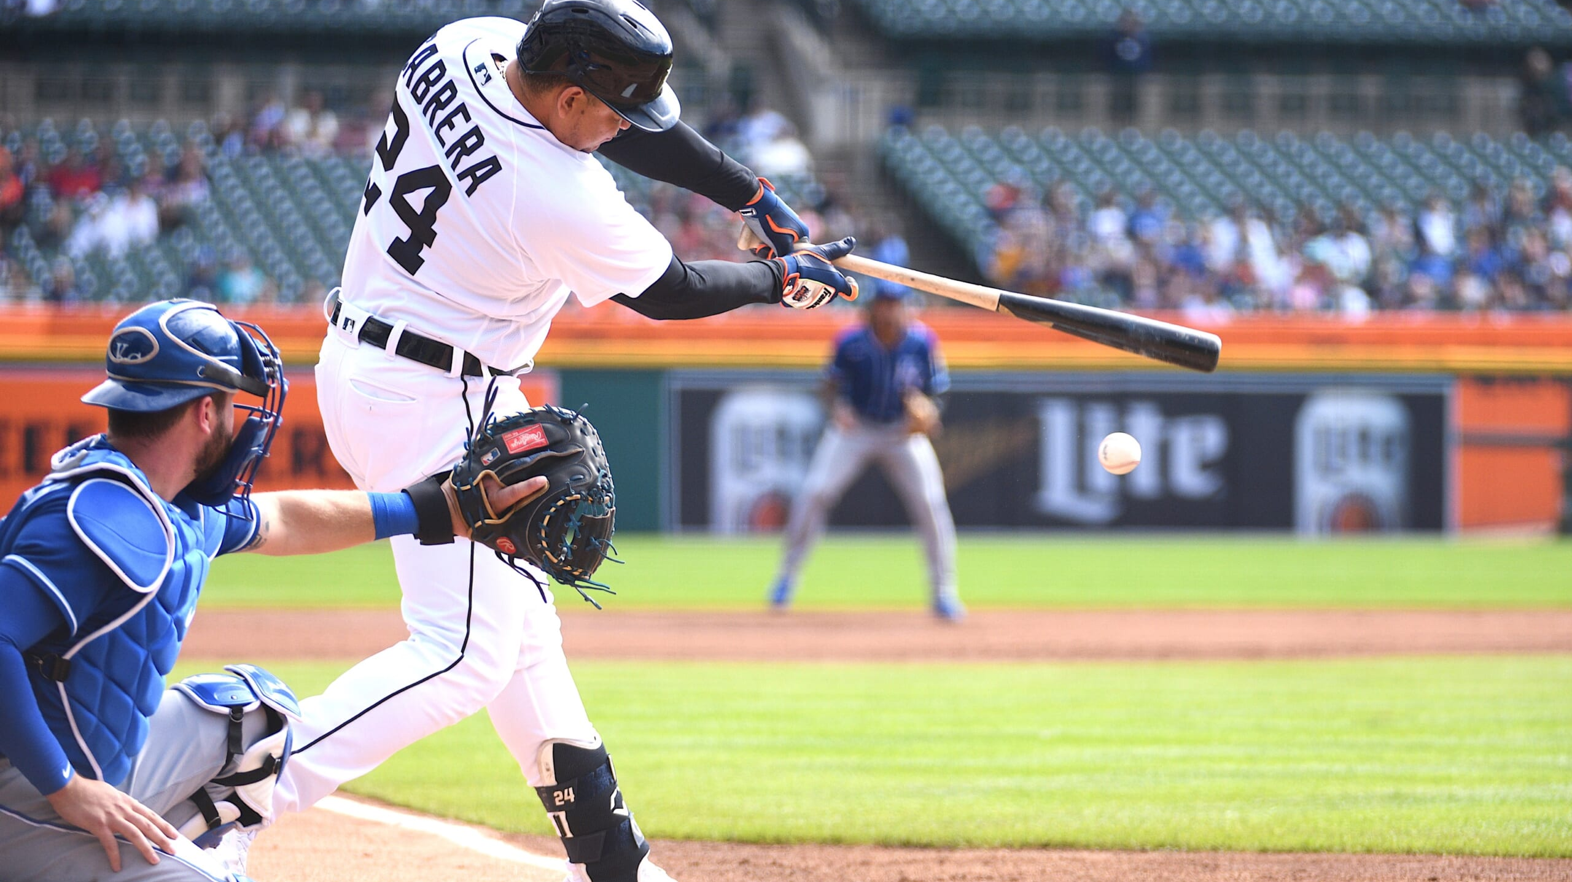
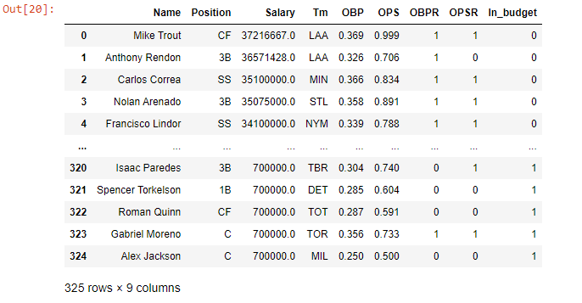
Batting Machine Learning Model
In this model we compare the 2022 players’ stats to the League Averages and created 2 clusters based on the results.
OBP = On-Base Percentage (0.320)
OPS = On-Base Percentage + Slugging Percentage (.728)
Salary = < $15,000,000

Slide 4
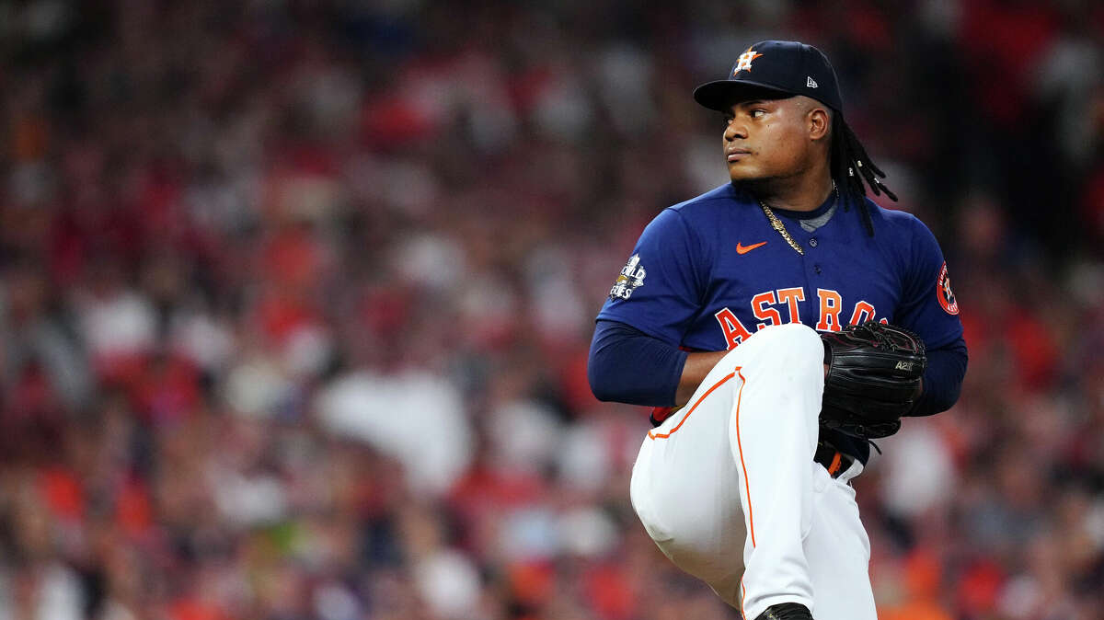
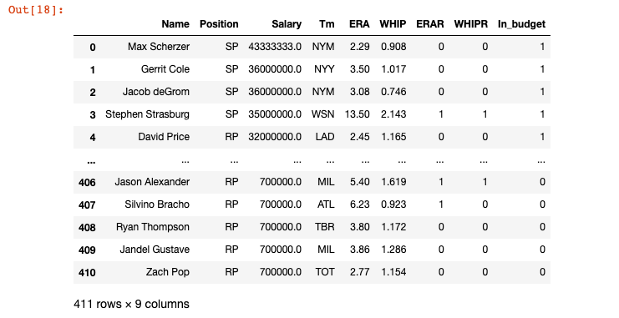
Pitching Machine Learning Model
In this model we compare the 2022 players’ stats to the League Averages and created 2 clusters based on the results.
ERA = Earned Run Average (4.28)
WHIP = Walks and Hits per Inning Pitched (1.316)
Salary = < $10,000,000

Slide 5
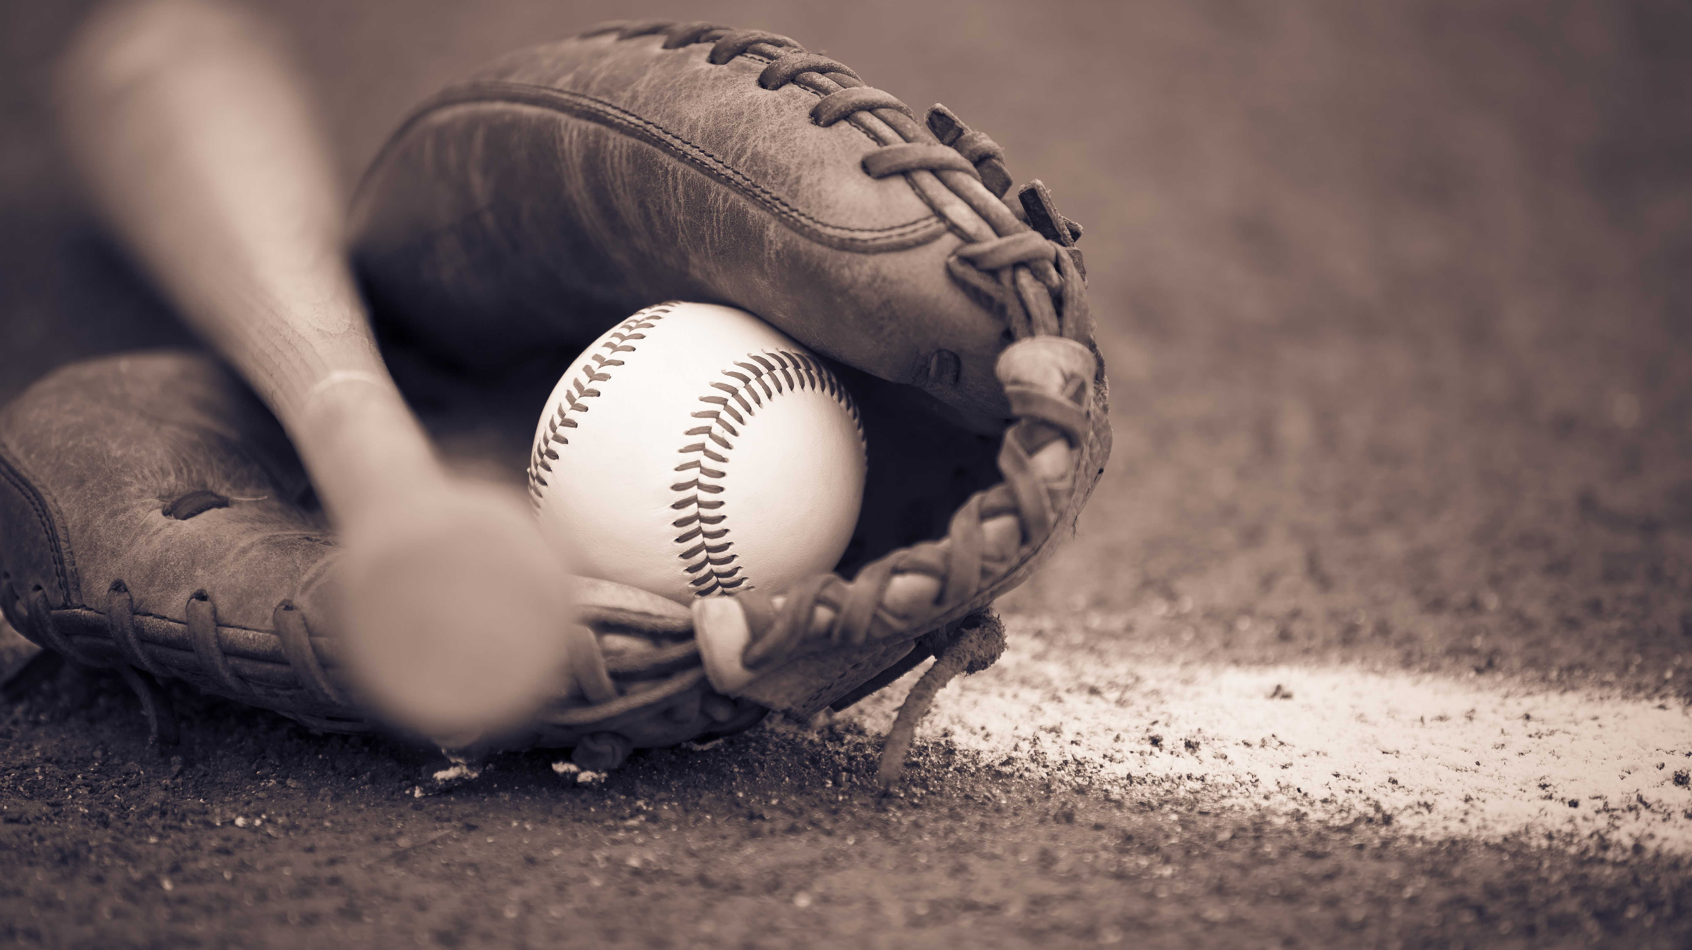
Catcher
Tom Murphy (SEA) – 1.58M
Garret Stubbs (PHI) – 705K
Infield
Pete Alonso (NYM) – 7.4M
Jeff McNeil (NYM) – 3M
Matt Carpenter (NYY) – 2M
Bo Bichette (TOR) – 825K
Otto Lopez (TOR) – 700K
Ty France (SEA) – 735K
Outfield
Joc Pederson (SFG) – 6M
Bryan Reynolds (PIT) – 6.75
Rob Refsnyder (BOS) – 800K
Ian Happ (CHC) – 6.85M
SELECTED PLAYERS
Pitcher
Shane McClanahan (TBR) – 711K
Tyler Glasnow (TBR) – 5.1M
Ross Stripling (TOR) – 3.79M
Shohei Ohtani (LAA) – 5.5M
Tyler Anderson (LAD) – 8.5M
Bullpen
Pete Fairbanks (TBR) – 714K
Matt Moore (TEX) – 2.5M
Angel de Jesus (DET) – 700K
Austin Adams (SDP) – 925K
Bryan Abreu (HOU) – 720K
Anthony Bass (TOT) – 3M
Erik Swanson (SEA) – 712K
Scott Barlow (KCR) – 2.4M
BUDGET
$75,000,000
Total: $72,600,000

Slide 6
How did our model perform?
Let’s find out!

Slide 7
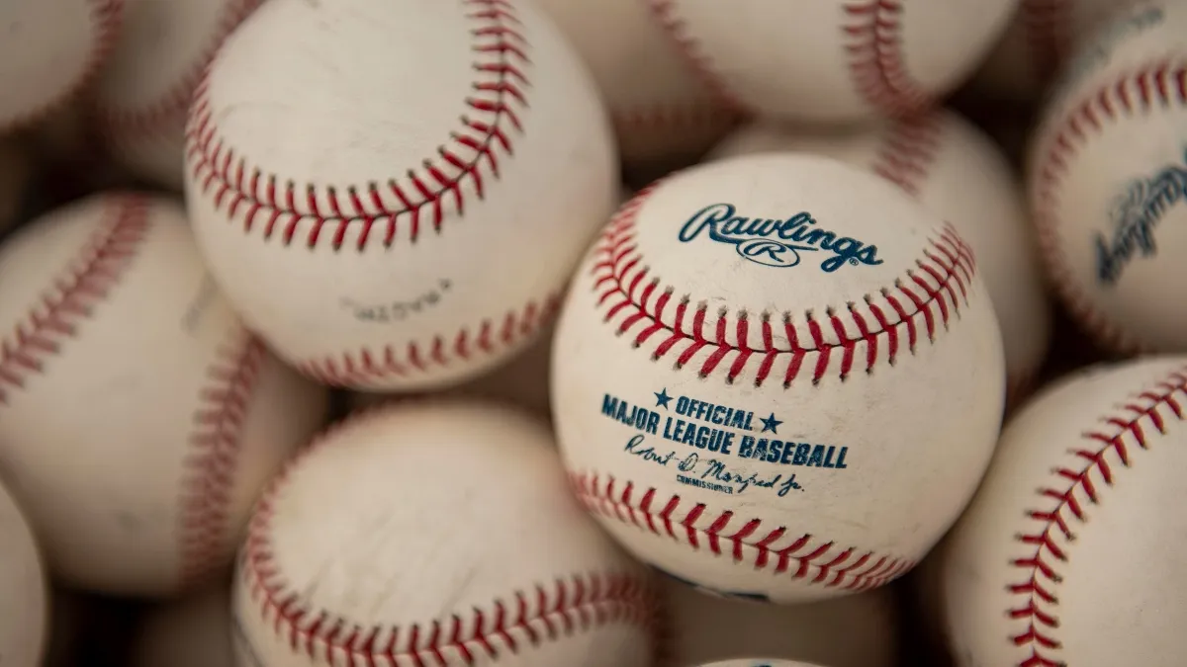

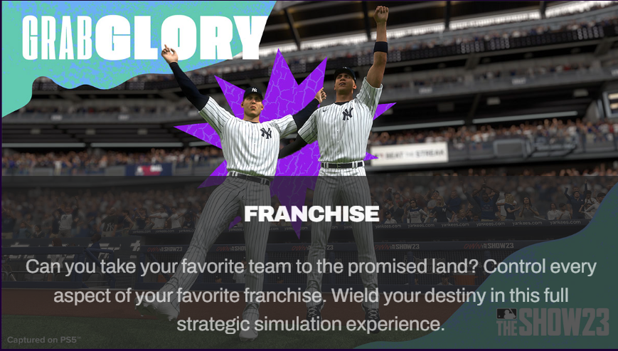
When the real world isn’t enough?

Slide 8
SIMULATED SEASONS TO PROVIDE INSIGHTS
Ten seasons were fully simulated by the game to observe our fantasy lineups potential.
The Oakland Athletics roster were switched out for our selected players.
These simulations were also used as a direct comparison to our projections based on the player performance during the 2022 season and real world performance through May of the 2023 season.

Slide 9
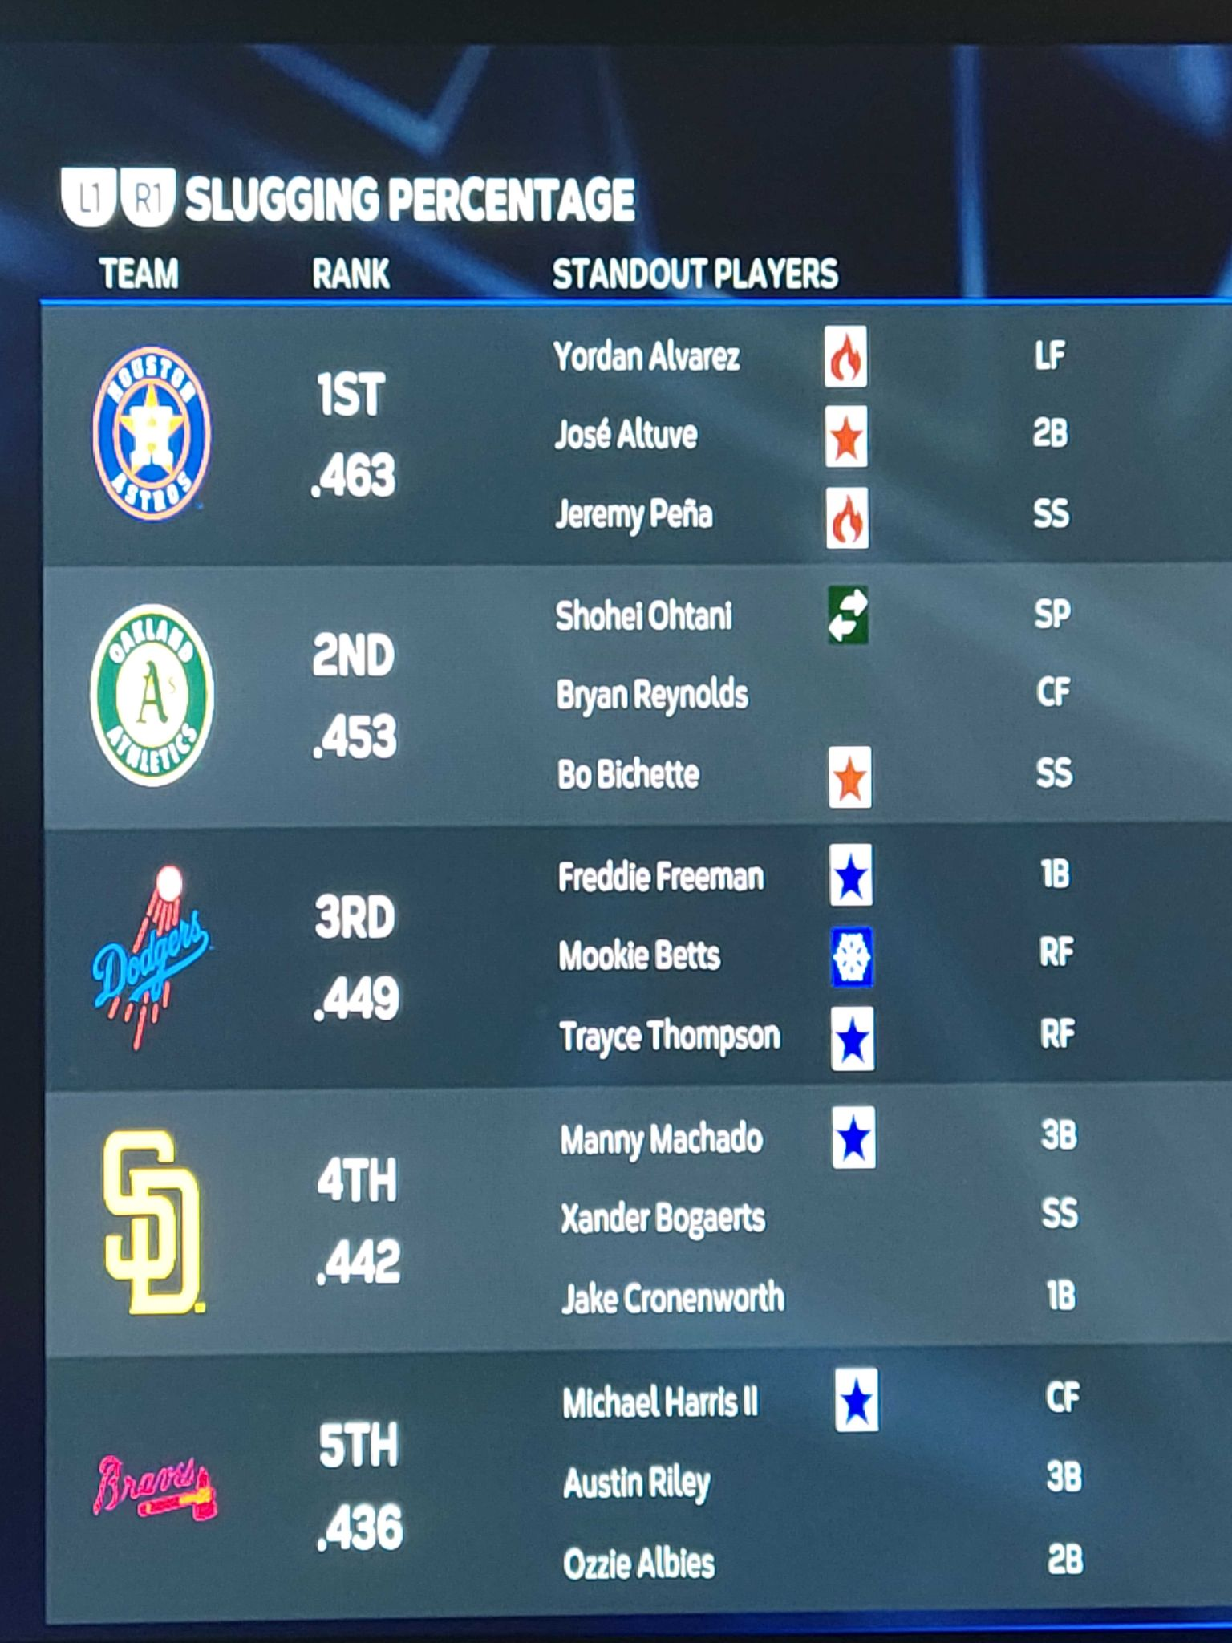
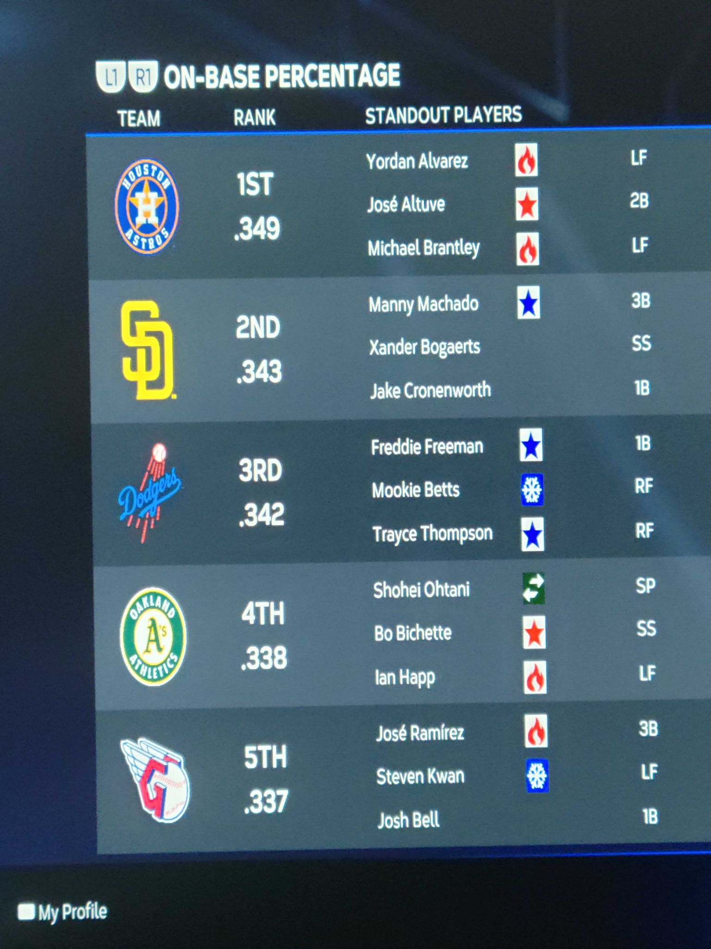
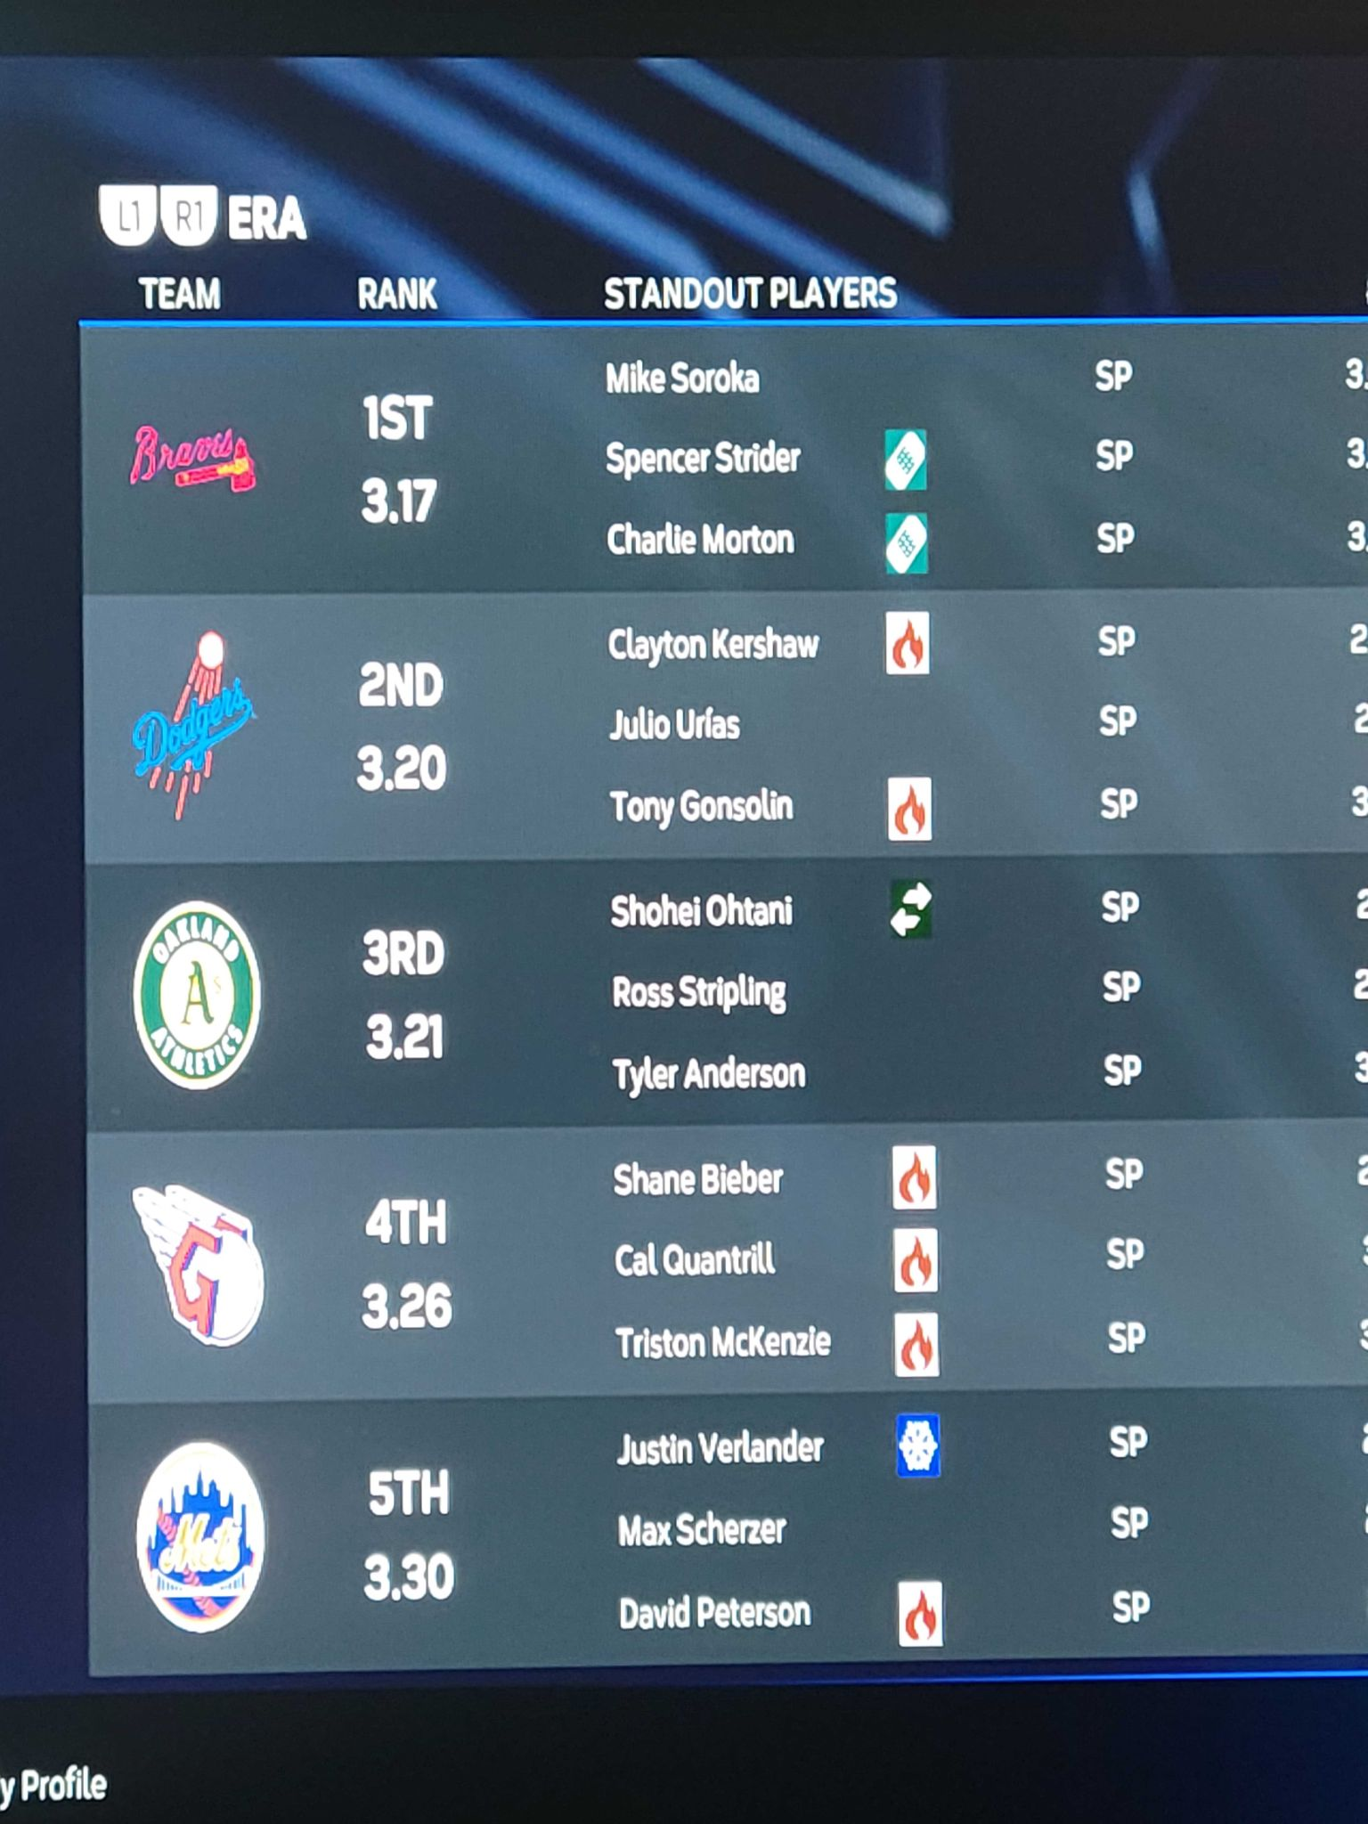
OUR BEST SEASON
Record: 104-58
Division Champs
Swept in Divisional Playoff

Slide 10
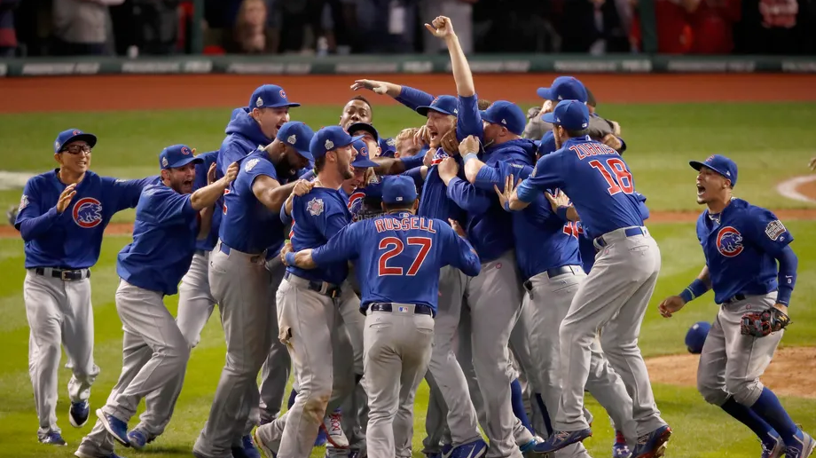
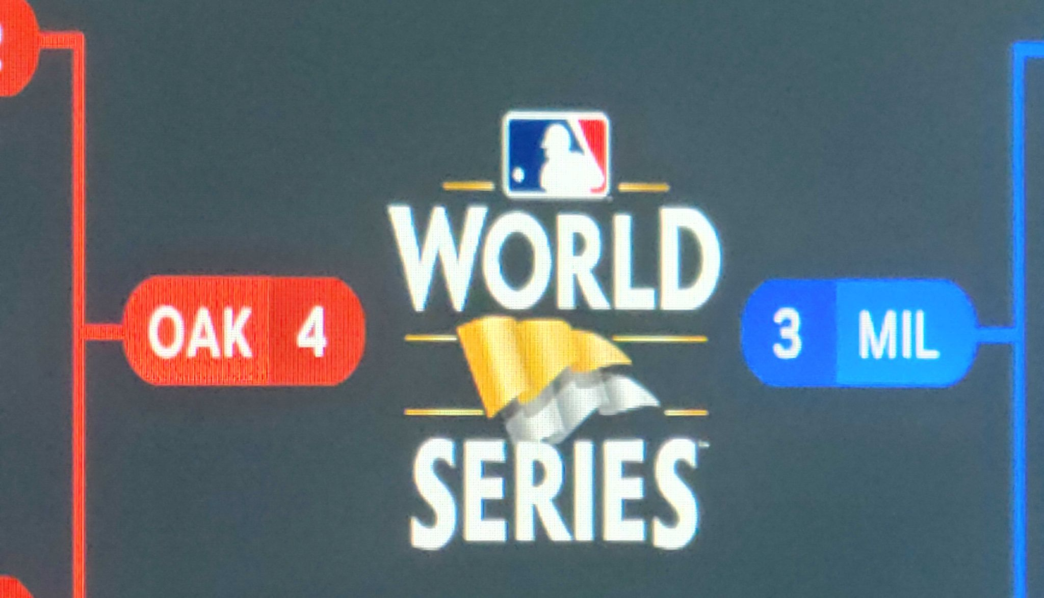
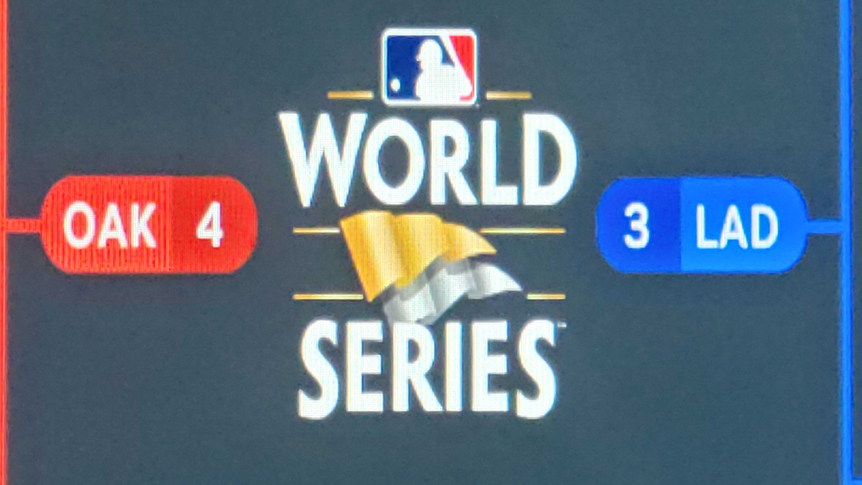
Winning isn’t everything, but…
2X SIMULATED WORLD CHAMPIONS

